Slide 1
October 2023
www.sheffieldscientific.com
Building an Application to Manage Queries in Maximo
Stephen Hume Maximo Director
Bonus Content: How to configure the application to change owner of a query

Slide 2
Outline
Introductions
Objective (Maximo Features Used)
Application Designer
Database Configuration – Relationships
Security Administration
Automation Scripting
Naming Standards
Documenting Implementation Steps while you go
Creating The New Application
Adding data from related tables to the application
Additional configuration of the application
Creating the Automation Script linked to an Action
Adding the Button to Trigger the Automation Script
Testing the Application
New Feature – Change Query Owner

Slide 3
Introduction
Stephen Hume
Stephen has worked with Maximo for over 20 years and was the past president of the Canadian Maximo User Group. He is also the founder of the Maximo Technical User Group
He is currently the Maximo Practice Director at Sheffield Scientific LLC.

Slide 4
Overview
The purpose of this new application is an administrative tool to allow an admin user the ability to modify queries
which have been created by any users in Maximo. The admin user will be able to set a user query as public or private, modify the SQL, and change the Query Description. The admin user will NOT be able to delete any queries created by another user using this application. (The MBO rules are still enforced).
This application is very useful for managing all queries in all applications in Maximo. It allows the admin user to see where queries have been used on start centers. It allows the admin user to see all queries created by users that may no longer be active in Maximo.
One use case for this tool is that when a user has left the company, the admin user can grant that user access to the query management application, reset the users password, log in as that user, go to the query management application and then delete that users queries one at a time. This allows the admin user the ability to keep on top of user queries.
Much of what this application makes possible used to need to be done using back end database updates for query management.

Slide 5
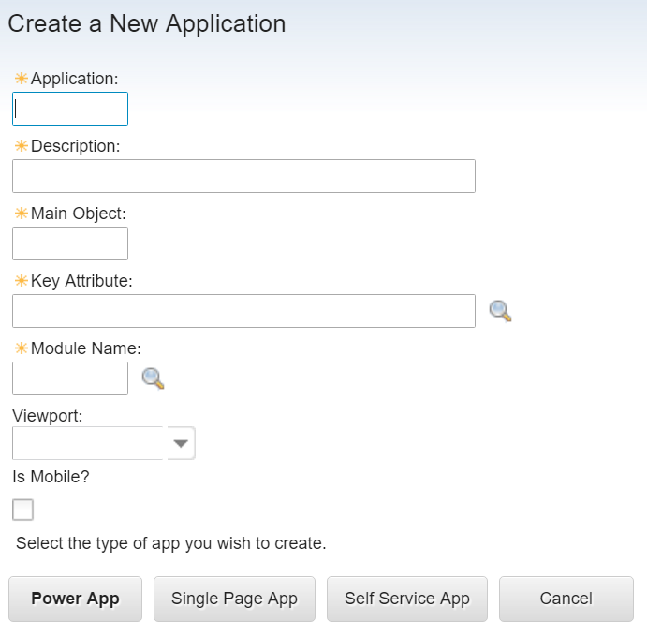
Creating the New Application
Information you need before you create the application:
- Name and Description of the new application
- Module where the new application is going to reside
This will be whatever you want to name your application, we called it SS_QUERY
Query Manager
QUERY
QUERYID
SETUP
TIP
When adding this application into other environments
you can use migration manager to move all changes, or you can do these steps manually.

Slide 6
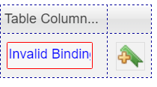
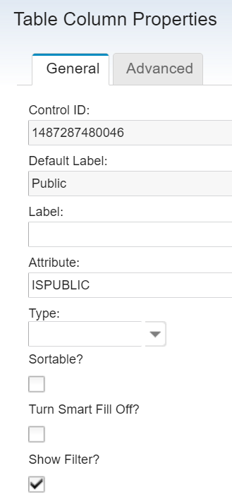
Add Column to the List Tab
Need to add the PUBLIC flag to the list tab to allow you to filter for public and private queries.
Click and Drag a Table Column to the last place on the Right
Right Click on that field and select properties
Attribute = ISPUBLIC

Slide 7
Adding Data from Related Tables
Adding a table showing which Start Centers are Using the Query
Create the relationship to the SCTEMPLATE table
NOTE: This relationship only needs to be created once for this class. It can be used by all students.
Adding the table to the applications details tab Click and drag a new section onto the application details tab at the bottom
Then click and drag a table into that section. Right click on the table and select properties
NOTE: The clause above has been tested and works with the training database (which is DB2).
It may need to be modified if your database is SQL Server.
For an Oracle database the || concatenation works but for SQL Server the Where Clause needs to be "presentation like ('%' + :clausename + '%')"
TIP

Slide 8
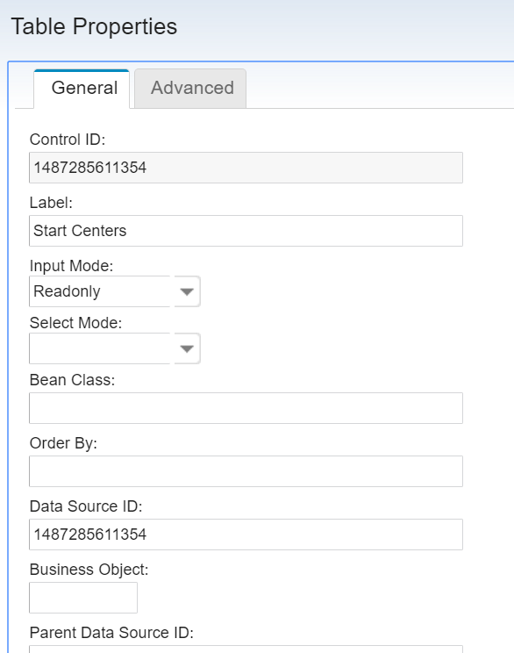
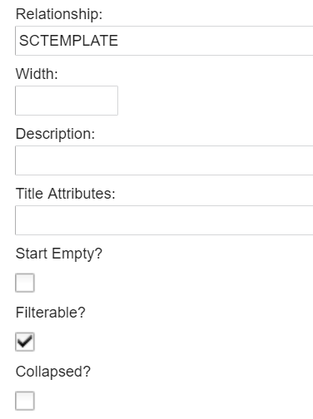
Adding Data from Related Tables
Properties of the table – Relationship = SCTEMPLATE – datasource ID and Control ID will be different for
each student
NOTE
Make the input mode for the table = readonly so that the data cannot be updated by the user.

Slide 9
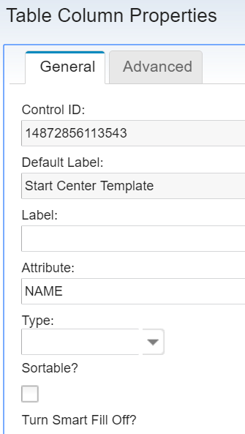
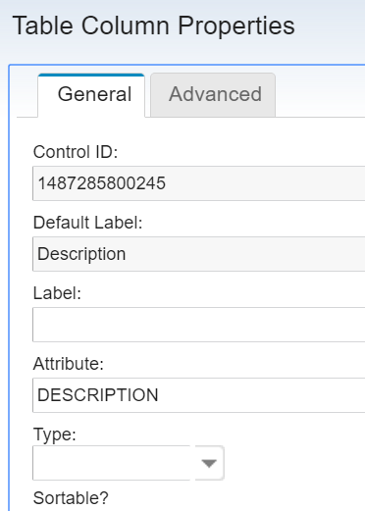
Adding Data from Related Tables
Add two table columns to the table here are the properties for each column

Slide 10
Testing the Application
Save your changes then OPEN the application under the Administration Module
Hit ENTER on the list tab to get a listing of all queries in the system.
Then click on the first QUERYID to open that Query.

Slide 11
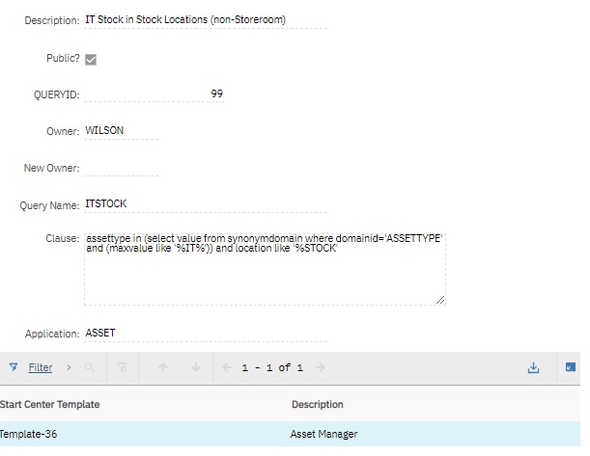
Testing the Application
Scroll through the Queries by hitting the Next
Record Icon
When you get to a query that is used on any start center
You will see that the start center information is provided.
You should never make changes to a query that is on a start center. (the start center resultset will no longer work if you do)

Slide 12
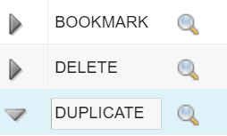
Further Refining the Application
When an application is created, Maximo by default creates certain signature options, select action entries and Tool Bar Items, also by default it gives access to those options to the MAXADMIN security group.
Removing, hiding, renaming signature options
Removing Select Action Items
Remove Toolbar Options
NOTE
You will only be able to delete queries for which you are the owner.
Uncheck the Visible Flag on the following Options INSERT

Slide 13
Create Automation Script for the App
The problem here is that out of the box the QUERY can never be updated by anyone except the person that created the Query. You could change the “creator” of the query in the backend database, but this would make the Query fail on any Start Centers where it might be used.
NOTE: The first time we created an automation script for the Query Management application, it was created as an object level automation script. It was design to run automatically so that Queries were always editable by the Admin User.
When we upgraded to 7.6 it was noted that start centers were not loading properly when users logged in, we traced this back to the automation script which was looping through every query and trying to override read-only features. We then converted the automation script to only fire when a pushbutton is pushed, making much less intrusive to the system.
Lesson learned from this – Automation Scripts need to be used with care as they can truly cause system performance issues, and in the least expected way.

Slide 14
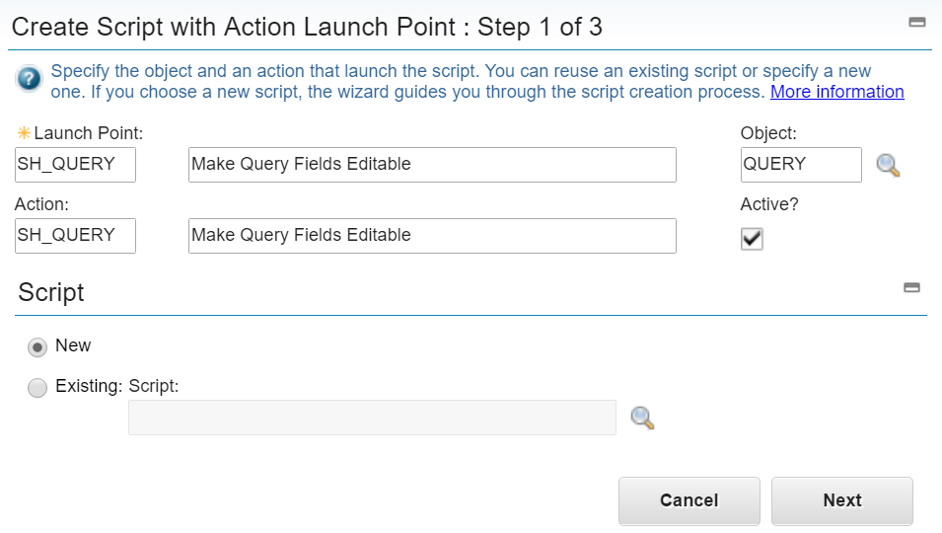
Creation of the Script
Go to the Automation Scripts Application and in the left hand menu click Create – Script with Action Launch Point.
Give the Launch Point a Unique Name It will be copied to the Action Field You can use the same description for the launch point and action The OBJECT for this script is QUERY

Slide 15
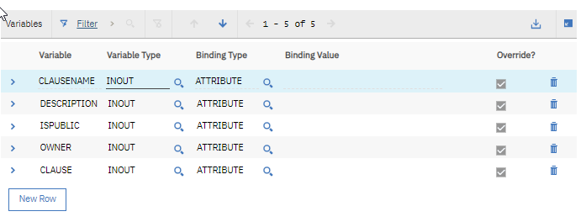
Creation of the Script
Create the script name (Make it the same as the launchpoint name)
Then add five variables: CLAUSENAME DESCRIPTION ISPUBLIC OWNER CLAUSE
And for each one click Suppress Validation Suppress Access Control and Suppress Action
Then click NEXT

Slide 16
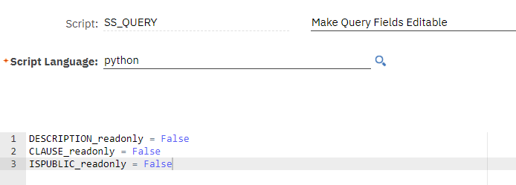
Creation of the Script
Then input the Source Code for the Script and then click the CREATE button
At this time, the ACTION will be created by the system.

Slide 17
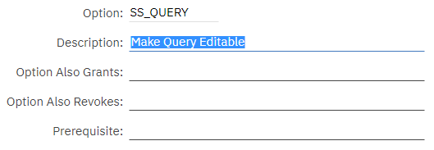
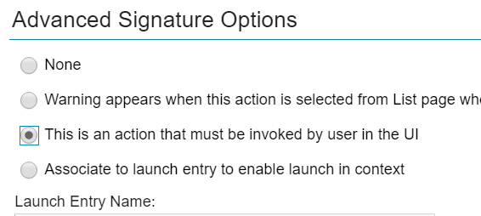
Adding Button to the Application
Open the application you created in application designer, then create a new signature option (same name as the action you created)
NOTE
Be sure to check the action option for the Signature option or it will not do anything when you
click on the button in the application.

Slide 18
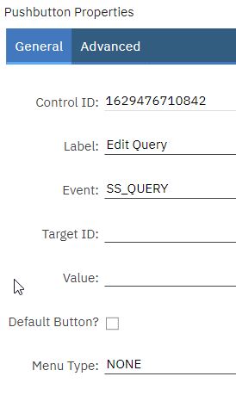
Adding Button to the Application
Drag a Pushbutton Object onto the body of that tab
Then edit the pushbutton properties Label: Edit this Query Event: the name of the action you created
Click SAVE – you then need to go to the Security Groups Application and give access to MAXADMIN Group to the new Security Option.

Slide 19
Grant Security Access to the Button
Go to security groups application filter to the MAXADMIN group On the applications tab filter to your Query Management Application Then in the signature options make sure the option you create is checked
Save your changes, log out of Maximo, Log back in and then go to your Query Management application to test the pushbutton.

Slide 20
Test the Application
Go to the Query Management Application you created and test the full application,
Record to record navigation, the unlocking button, displays of person name, status, width of columns.
You can make adjustments to your design using the application designer, move fields around,
Re-position the pushbutton, adjust field widths, etc.
Once you are happy with the application it would be ready to move to your QA (pre-production environment).

Slide 21
New Feature – Change Query Owner
The reason for wanting to be able to change the owner of a query is so that you as the administrator can delete queries that might have been created by a person who no longer works are your company, and that are not used on a start center.
Unless you are the “owner” of the query you cannot delete it.
It is very important to note, that this should never be done to a query which is used on a start center!
Changing the owner or clause for a query on a start center, will cause that portal to fail on the start center.

Slide 22
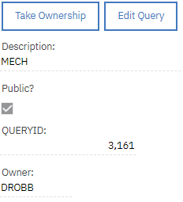
New Feature – Change Query Owner
This is what the end product will look like when you have added the Take Ownership button to the application

Slide 23
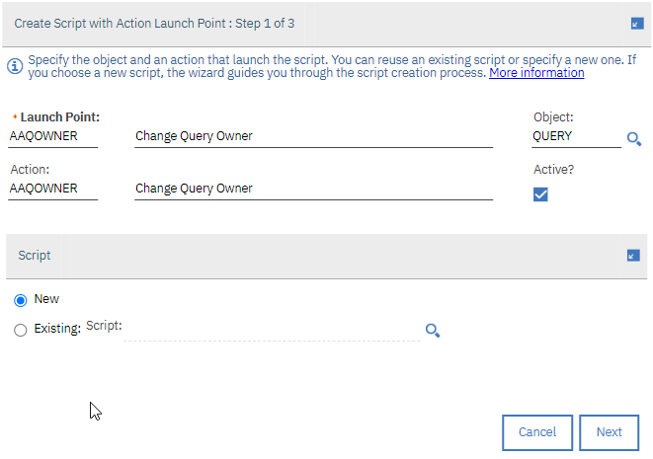
New Feature – How to make this work
Step one: Create a New Action Automation Script:
Your Launch Point and Action will have the same name.
It is also the name you will need give the signature option you will create in the query management application.
When you have filled in the Launchpoint, description, Action description and Object, click the Next Button

Slide 24
New Feature – How to make this work
Step one: Create a New Action Automation Script:
Your Script can have the same name, language can either be Python or Jython
Then click the Next Button

Slide 25
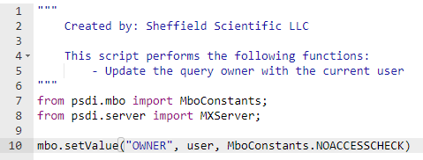
New Feature – How to make this work
Step one: Create a New Action Automation Script:
"""
Created by: Sheffield Scientific LLC
This script performs the following functions:
- Update the query owner with the current user
"""
from psdi.mbo import MboConstants;
from psdi.server import MXServer;
mbo.setValue("OWNER", user, MboConstants.NOACCESSCHECK)
Create the script as above… this will set the owner of the query to the current user when the action is run.
The source code is above in the black box so that you can copy and paste into the automation script.

Slide 26
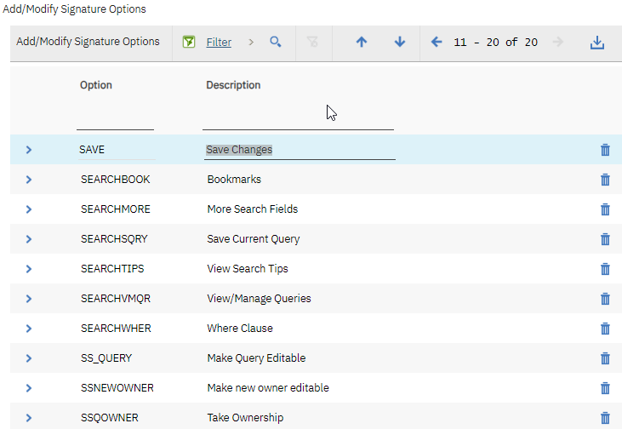
New Feature – How to make this work
Step two: Add Action to the Application
In application designer, chose the option to add/modify Signature options.
Add a new signature option with the exact same name as the action you just created (i.e. SSQOWNER)
It is very important for this signature option that you click on the Advanced Signature Options and select This is an action that must be invoked by user in the UI

Slide 27
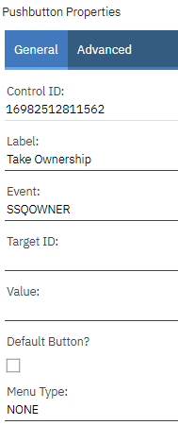
New Feature – How to make this work
Step three: Add pushbutton to the application
The properties for the push button are:
Label: Take Ownership
Event: (the name of the action you created)

Slide 28
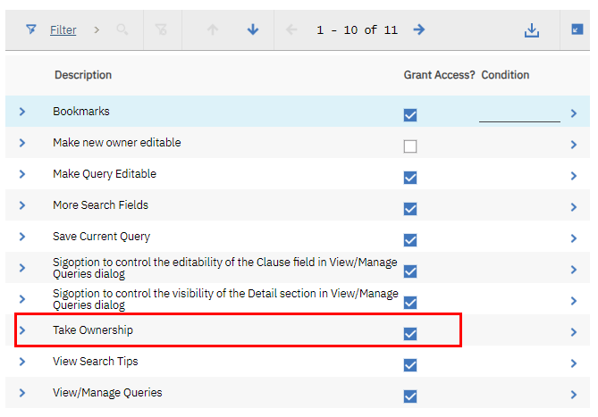
New Feature – How to make this work
Step four: In the security group application grant access to this new signature option
This would be done for whichever security group should be able to do this in your organization.
Assuming you are a member of the group, once you save your changes, you need to log out of Maximo and log back in for the security changes to take effect.

Slide 29
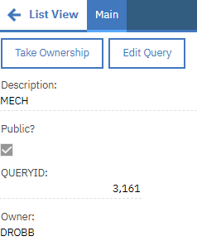
New Feature – How to make this work
Test the application
Open the application and find a query where you are not the owner.
Click the Take Ownership button and you should see the Owner field change to your userid.
Once you click save you will notice that the query is now fully editable and also it you try to delete the query the system will allow you to do so.

Slide 30
Credits and Acknowledgements
I want to acknowledge my long-suffering colleague and friend, Ken Thomson. He and I worked on the
first version of this application many years ago when we were learning automation scripting and
figuring out how to make read-only fields editable. We were also tired of managing Maximo Queries
using SQL directly in the database.
Since that time, I have shared the query manager application with hundreds of Maximo technical folks via MaxTECH, projects I have been involved with and by emailing it to my connections.
It has been used in places as far away as Tasmania, and New Zealand and is a well-regarded tool for many Maximo Administrators.

