Slide 1
Moving to MAS: Impact of the New Infrastructure Model
Troy Elsen
Director of Cloud Infrastructure Operations
Projetech

Slide 2
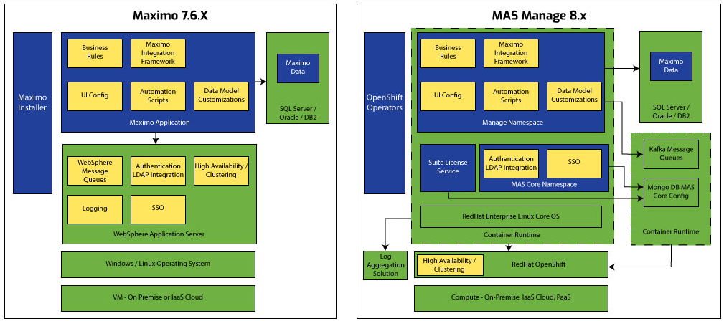
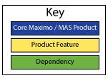
MAS 8 Platform Changes

Slide 3
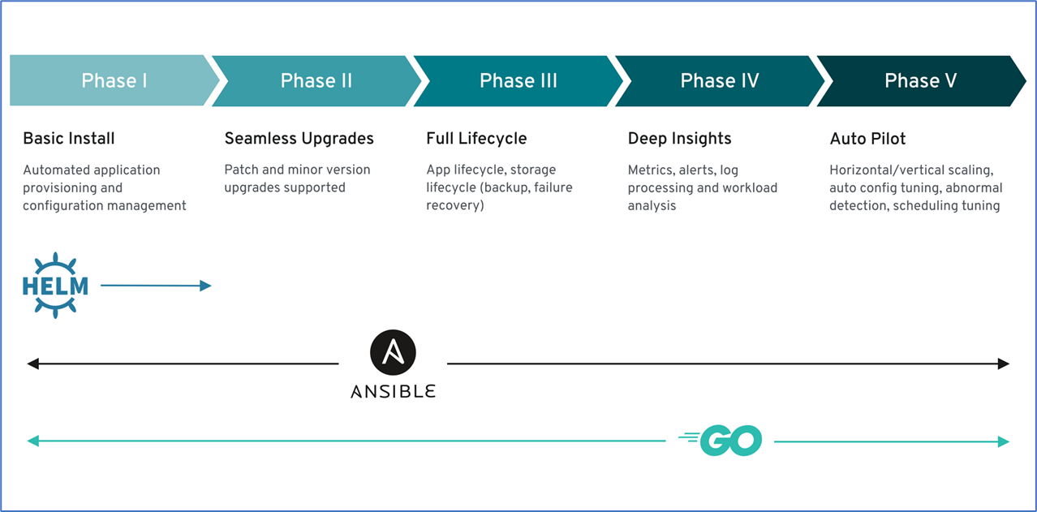
Why the Switch?
Consistency
Scalability
Portability
Change in Mindset and Skillset

Slide 4
Consistency
Containers
Faster startup
Decoupling Dependencies
Operators
Deployments
Health Checks
LifeCycle Management

Slide 5
Scalability
Service level scaling
Machine Config Pools
AutoScalers

Slide 6
Portability
On-Premise or Private Cloud
Public Cloud
Hybrid
Anything as a Service (XaaS)

Slide 7
Mindset Change
Cloud
Cloud First
Build and run anywhere
Dev life cycle
Micro Service architecture

Slide 8
Skillset Change
OpenShift
Workload management
Persistence
Monitoring
Platform
New and Old

Slide 9
Questions?
Troy Elsen
Director of Cloud Infrastructure Operations
Projetech

