Slide 1
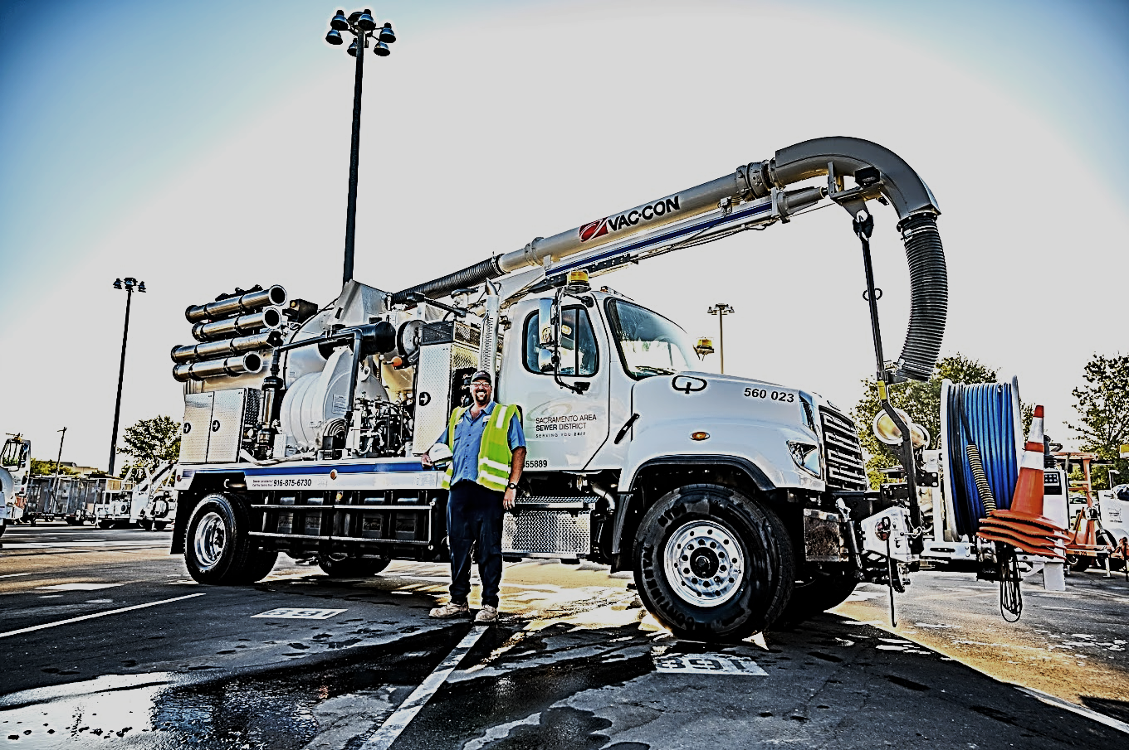
HOW PERFORMANCE TESTING WAS LEVERAGED TO ENSURE MAXIMO UPGRADE SUCCESS

Slide 2
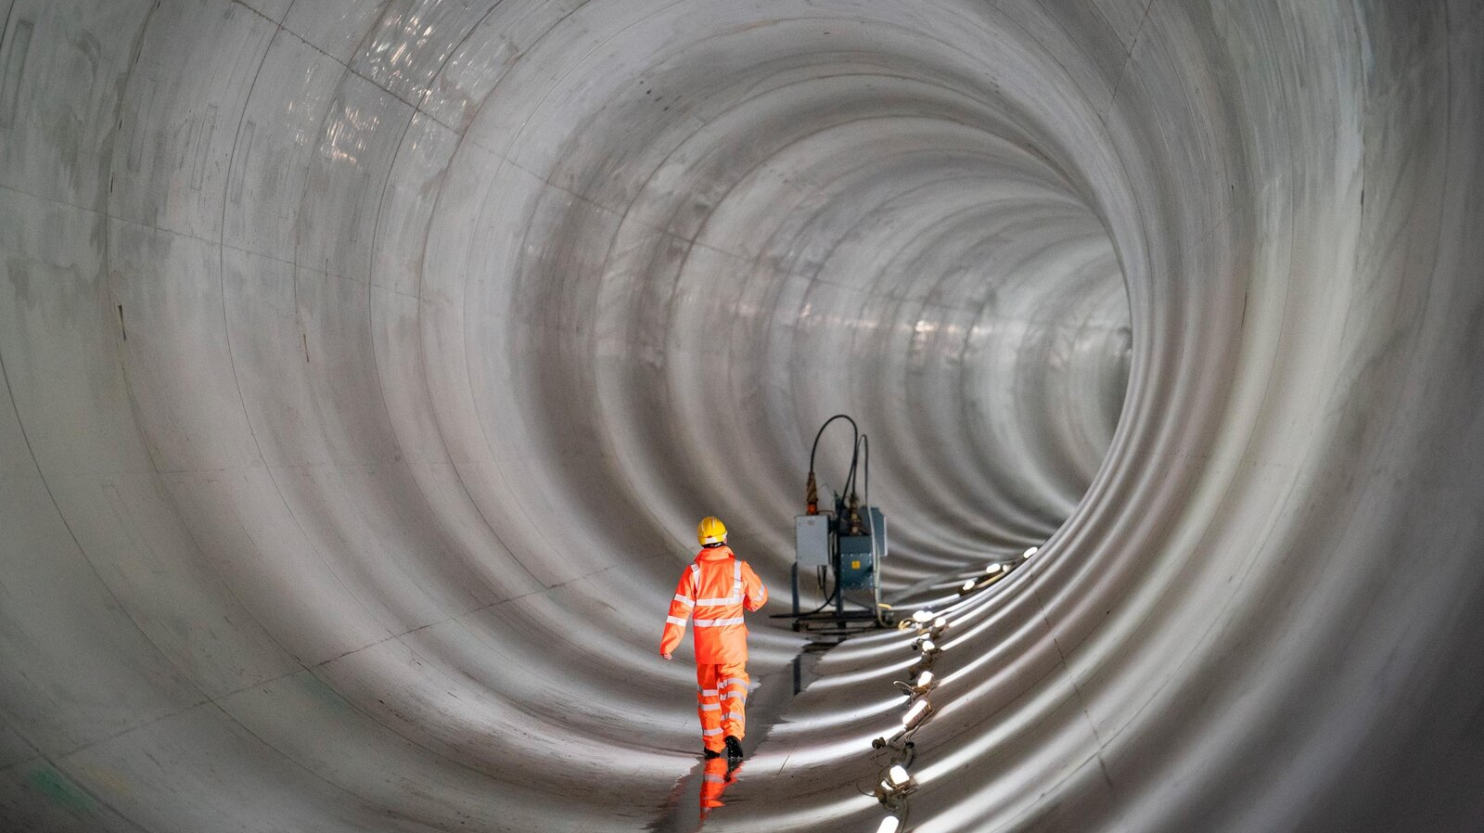
AGENDA
Introductions
Project Background
Project Objectives and Goals
Performance Testing
Key Lessons

Slide 3
JAYSUN HOWELL
Maven, Senior Consultant

Slide 4
ALEX DELIC
MaxTAF, Partner and Director of Business Development

Slide 5
DID YOU KNOW? Sacramento Area Sewer District (SacSewer) system is a vast and complex set of pipes — measuring 4,600 miles — that interconnect in a web-like pattern underground.
Sewage from their customers’ homes and businesses enters their system through small pipes connecting the property owner’s plumbing to our sewer main line. Once in the main line, sewage flows into a system of larger pipes called trunk lines. Our trunk lines connect to the Regional San’s system, which conveys the sewage to the wastewater treatment plant near Elk Grove. There, Regional San treats the wastewater and safely discharges it to the Sacramento River.
1,000,000 POPULATION
99.77 SQUARE MILES

Slide 6
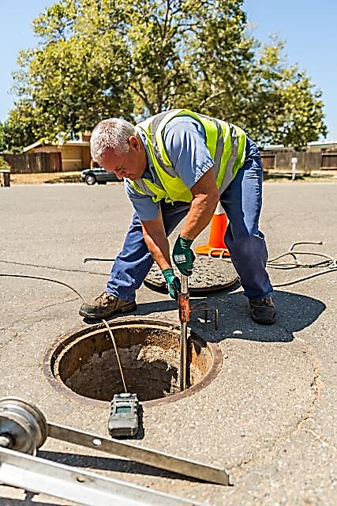
MAXIMO FUNCTIONALITY
BASE MAXIMO FUNCTIONALITY
Asset Management
Work Management
Supply Chain Management
SASD INCREMENTAL FUNCTIONALITY
Maximo Transportation solution
Maximo Scheduler
Maximo Utilities
Maximo Spatial

Slide 7
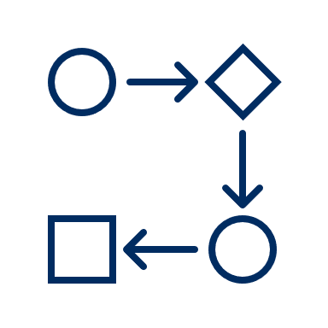
PROJECT OBJECTIVES AND GOAL
Business Process Management Improvement
Improved Maintenance, Tracking and Accountability of SASD
Improved, Enhancd Functionality to Support SASD
GOAL: A sustainable, stable Maximo 7.6.1.2 Upgrade with Spatial, Scheduler, Transportation, and Utilities’ Integrations

Slide 8
PERFORMANCE TESTING
Under this agreement, the client introduced performance testing as a requirement for the implementation. Hardware requirements discussions were held, and SacSewer decided to purchase the ‘Ferrari’ of hardware. It was ordered in the midst of the COVID outbreak and was delayed almost eight (8) months. This put the project roll-out in jeopardy. The team decided to spin up one of the environments on Virtual Machine’s (VM) and use MaxTAF, a specialized solution for automated IBM Maximo testing, to conduct performance testing. The VM’s were a no-go.

Slide 9
HOW DOES PERFORMANCE TESTING WORK?
User Journey Concept, Performance Orchestration, Test Execution, and Reporting.
3 minutes duration

Slide 10
CONDUCTING PERFORMANCE TESTS
User feedback was unacceptably slow Maximo
Performance testing reflected real Maximo usage more effectively
Baseline testing conducted in UK hours
No-go decision made
Green-lights achieved
THE TIMELINE
SEPT 2022 VM
JAN 2023
HARDWARE
Users involved during US hours
Investigation revealed unresolvable issues
Go-live decision made
Green lights from measurements and user feedback

Slide 11
DEFINING THE TESTS
User Journey Specification
Client provided MaxTAF with video recordings of Maximo workflows
Initially too long/complicated, so they were broken down

Slide 12
SIMULATION SPECIFICATION
Orchestration of tests reflected this real-world data
Client team explored historical Maximo usage data
THE TIMELINE
JAN 2023
Frequency of actions noted
*Difference between simultaneously logged in users and simultaneously active users
Scope of performance testing significantly reduced*

Slide 13
KEY LESSONS
Size your load appropriately!
Keep it simple
Use your historical data
Involve your users

Slide 14
QUESTIONS? JOIN US IN OUR BREAKOUT ROOM.

