Slide 1

The Criticality of Accurate Master Data
in Digital Transformations
Mike Jordan
VP – Asset Master Data Practice
Prometheus Group
Mobile/Text 1+ (256) 541-5883
mjordan@prometheusgroup.com

Slide 2


Reality is DATA is what gets you from where you are
… to where you WANT to go
DATA
Current State
Intelligent Enterprise
Notes:
Data governance talk-track
Bridge to S/4 – digital transformations
S4 readiness

Slide 3

While good data can be your most strategic asset…
Bad Data Can Be Catastrophic!
56%
8%
3%
of CEOs are concerned about the quality of their data.
of organizations have reached “transformational” levels of maturity in data and analytics.
of company data meets a minimum threshold for data quality.
Data you don’t trust
Isn’t data.
Sources
KPMG, 2017 Global CEO Outlook
Gartner, Survey Analysis: Traditional Approaches Dominate Data and Analytics Initiatives, Feb 5, 2018,
Harvard Business Review, Only 3% of Companies’ Data Meets Basic Quality Standards, Sept 11, 2017

Slide 4
Best Run Business Have the Advantage
“Best run assets witness 5x lower unplanned downtime / outages”
“Best performers have 5x lower
annual service and maintenance cost”
Annual Service and Maintenance Cost
(% of asset value)
Unplanned
Downtime/Outages
Return
on Assets
2.0% Best
2.2% Best
16.3% Best
6.4% Average
7.1% Average
11.3% Average
10.0% Worst
12% Worst
4.3% Worst
Note: “Best” = Top 25%, “Worst” = Bottom 25%
SAP Value Engineering, SAP EAM Benchmarking November 2016

Slide 5
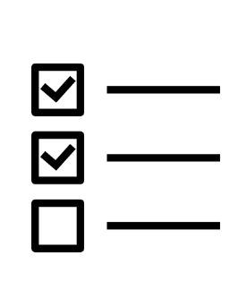





IoT Scenario 1: Spiral Effect of INCORRECT Asset Data
Motor
Sensors
Analytics
Maintenance Planning
MRO Supply Chain
Maintenance Action
Motor Failure
Pending
Readings Detected
Message transmitted to maintenance for action
Planner initiates work order based on erroneous asset information in maintenance system
Inaccurate asset data in MRO Supply Chain -leads to wrong spare parts ordered/ issued
Maintenance worker arrives to fix the wrong motor, with wrong instructions, and wrong parts delaying fix
Motor Fails

Slide 6
IoT Scenario 2: Positive Outcome from Accurate Asset Data
Motor
Sensors
Analytics
Maintenance Planning
MRO Supply Chain
Maintenance Action
Motor Failure
Pending
Detects abnormal readings
Predicts failure pending
and notifies maintenance that action is required
Maintenance planner compiles appropriate maintenance plan & task list – requests appropriate spare parts, initiates work order
Issues appropriate replacement parts
Prepared maintenance worker performs effective repair of motor
Minimal Business Interruption

Slide 7
Three steps you can take NOW
To prepare for Digital Transformation

Slide 8
1. Assess your data quality

Slide 9
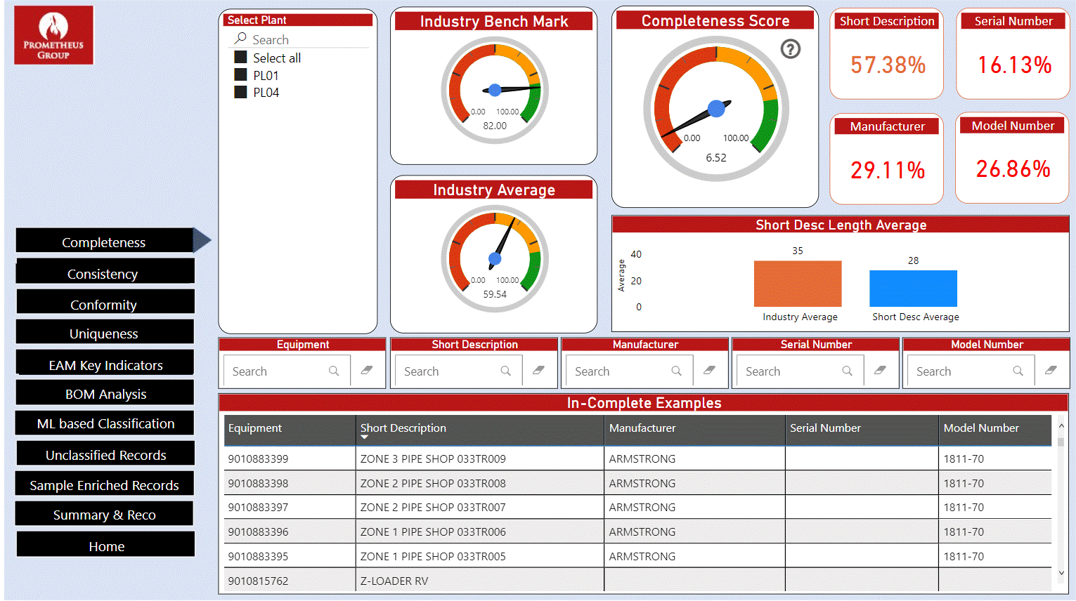
Data Health Assessment

Slide 10
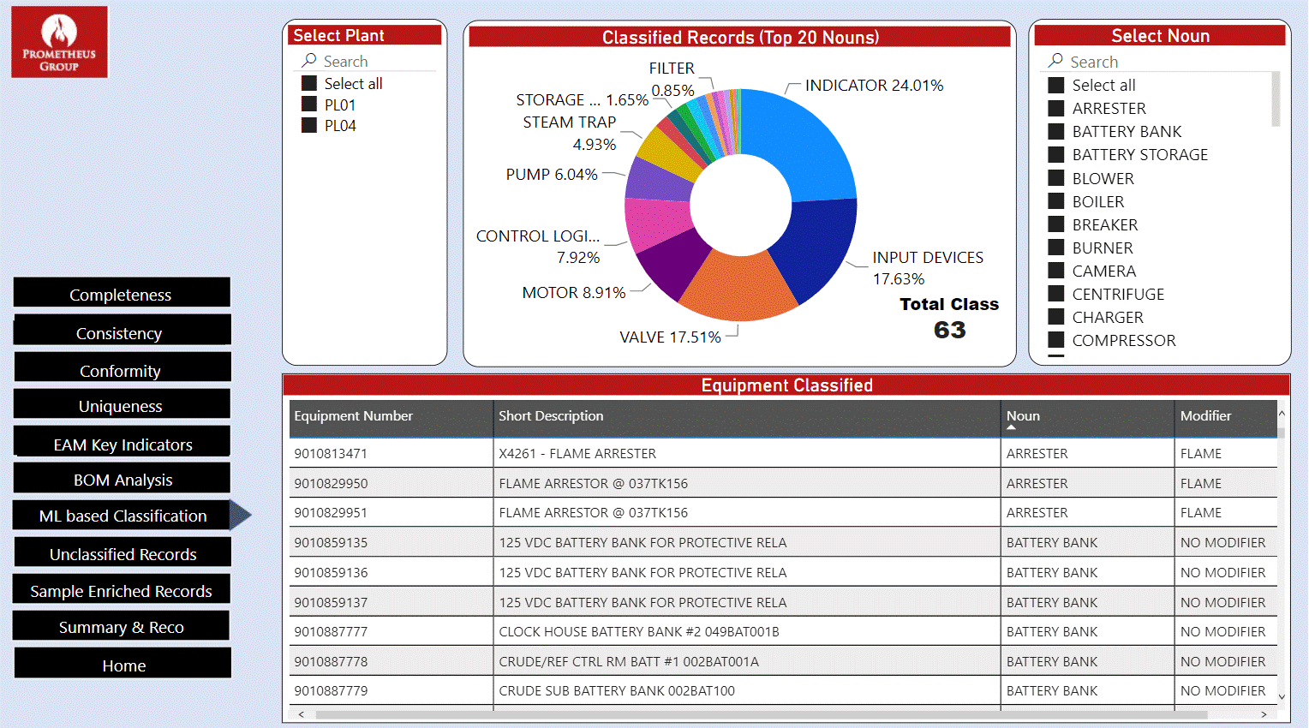
Data Health Assessment

Slide 11
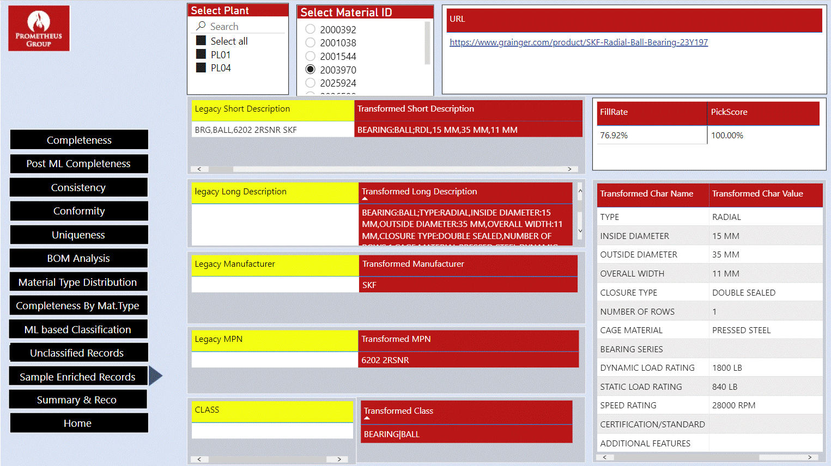
Data Health Assessment

Slide 12
2. Quantify the business impact of inaccurate, incomplete asset information

Slide 13






The Business Impact
Improved Maintenance Productivity
Increased Operational Efficiency
Increase maintenance ‘wrench-time’
Added cycles for deferred maintenance
Improved asset information context for informed troubleshooting & repair
Reduce downtime from equipment failure
Lower mean-time-to-repair
Increase asset availability
Ensuring accurate, complete asset master data can have a direct impact on reducing environmental, health & safety risks, improving operational performance and maintaining regulatory compliance.
Reduced MRO Supply Chain Costs
Decreased EH&S Risks
Enables accurate prediction of spares needs
Facilitates identification of obsolete inventory
Minimizes expedited procurement
Accurate, complete information enables informed decisions, reduces risks for maintenance staff and operators
Improved Auditability
Achievement of Operational Excellence
Improved financial accountability
Ensures regulatory compliance
Reduces product liability risks from quality
Enables achievement of top quartile performance through advanced maintenance techniques such as reliability-centered-maintenance, risk-based inspection, performance analytics

Slide 14



Typical Business Benefits from Master Data Improvements
Estimated Savings*
$
Master Data
Maintenance Productivity
Utilization and Working Capital
Unplanned Downtime
Master Data Mgt. / EAM
Maintenance Productivity
Cost of Maintenance
Asset Utilization
Working Capital
Soft Benefits
Not Quantified
Reduced equipment corrective maintenances/break-fix orders
Improved visibility into equipment reliability performance
Better failure diagnostics with an integrated view of process upsets
Complete maintenance documentation for prescriptive actions
Data cleansing, standards, rules, and governance enable trusted data
MDG templated process controls data consistency for edits, changes
Governance simplifies process to prevent, inconsistencies
RPA, ML automate asset master set-ups, maintenance and usage
Automated processes and availability of digital records improves repairs
Increased closure of work orders due to right equipment data and history
Reduced work order backlog due to real-time visibility to completed WOs
Reduced costs per work order due to shortening of completion time
Reduced maintenance service costs due to improved planning
Increased focus on critical assets, hence progressive reduction of cost
Reduced failures and maintenance cost caused by excessive maintenance
Improved obsolescence management; repair vs. replacement decisions
Improved ability to align product demand with production planning
Increased flexibility to change production planning based on market demand
Improved visibility to production status to improve portfolio decision making
Increased performance visibility improves investment decisions
Improved visibility to work execution and budget to drive decisions
Better allocation of funds to support work execution, materials, and projects
Increased ability to shift and re-allocate budget to projects when needed
Real-time tracking of commitments, costs, spend and completed work
Standardizes equipment class, description and terminology
Increase visibility to resources and equipment utilization
Provides digital foundation for next-generation operations
Reduces complexity and integrates siloed data sources
Improves operations agility/flexibility for demand changes
Maximizes asset productivity and enables safer operations

Slide 15
2. Develop a data foundation for your digital transformation

Slide 16
Data Governance Strategy
1
2
3
As-Is Assessment
Data Governance
Framework Development
Data Governance Program Integration
Assess
Deploy
Propose
Understand Current State
Highlight Best Practices
Develop a Governance Roadmap
Identify People and Process Gaps
Determine Objectives
Evaluate Organizational Needs
Develop Goals and Approach
Align
Build Operational Structures
Seek Executive Support
Enable Master Data Management
Empower Organizational Change
Strategy Development – 12 weeks

