Slide 1

Maximo Roadmap – A look to the future
June 2020

Slide 2


A Roadmap for Maximo EAM –
What's new in the latest 7.6 release and journey toward Maximo 8
Date: Wednesday, July 22, 2020
Time: 12:00 EDT
David Gasdia
Program Director
Kim Woodbury
Senior Offering Manager
Register Now
Join us to learn about the newest features being delivered in Maximo EAM 7.6.1.2 being made available this week!
There are many updates being delivered to improve the experience of Maximo end users including an optional new and improved drilldown navigation. There are also many technical updates and new capabilities that respond directly to customer requested enhancements.
We'll also talk about the introduction of the Maximo Application Suite (Maximo 8), and provide insights on how the results of that journey will allow you to take advantage of the entire Maximo portfolio and ensure the success of your asset management investments for years to come.

Slide 3
Investment in EAM Capabilities – 2H 2020 deliverables
Maximo 7.6.1.2
Work center enhancements
Address customer RFE’s - multiple attachments, ERD builder, Updated drilldown navigation, email listener protocols, display of embedded images
Push Notifications
Security and Currency updates
Location Based Services/Spatial
Offline mapping improvements
Data/Security layers
ArcGIS Online data synchronization support and use of feature services
Scheduling
Improved User Experience
Heatmap for Graphical Assignment
Calendar resource views
UX Enhancements (e.g. Inline editing)
Optimization improvements using ILOG CPLEX studio
Data cleansing pre-processing tools to ensure optimization success
Industry Solutions
Oil & Gas / Health Safety Environment Manager
Permit to work
Regulatory guidelines
Incident management
Civil Infrastructure
  Create/View Defects in 3D and Linear Views
  Enhanced Import/Export of Asset Hierarchies
  Sample Bridge Health Score model
IBM Maximo / © 2020 IBM Corporation
IBM Maximo / © 2020 IBM Corporation

Slide 4
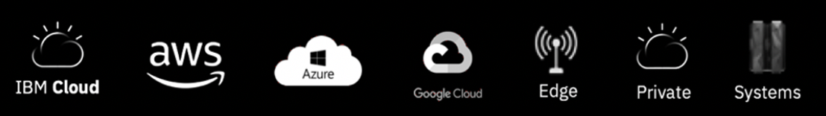

Maximo Application Suite: A New Model for Software
Maximo 8.0 – GA May 29, 2020
Faster Hybrid Installation
All Applications in one Suite
Simplified Licensing
The Application Suite effort is driving the journey for hybrid software built on RedHat OpenShift
Learn more here
IBM Maximo / © 2020 IBM Corporation

Slide 5











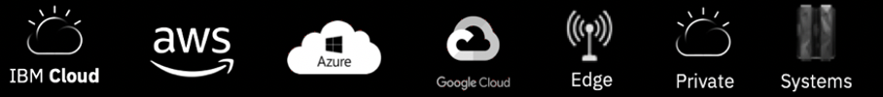
Maximo Application Suite Benefits
Suite Applications
Single license
- One entitlement to entire Suite
Flexible consumption
Sharing of license through concurrent users
Simplified usage
- Expanded access to all capabilities
Manage
Intelligent asset management
Scheduler
Schedule work and resources
Monitor
Monitor and
detect anomalies
Health
360-degree view of assets
Predict
Predict failures earlier
Mobile
Technician work execution
Assist Prescriptive assistance
Safety
Actionable insights for safety
Visual Inspection
Visual anomaly detection
IBM Cloud Pak for Data | IBM Watson Studio | IBM Watson ML | DB2
Infrastructure Independent
Common Operating Environment
5
Notes:
Built on the Red Hat OpenShift Container Platform: for optimized scale and availability on on-premises, private and public clouds, or hybrid environments
Customer managed: Purchase MAS and deploy in the environment of your choice
IBM Managed: Purchase MAS and hosting, and let IBM’s trusted team take care of everything for you
Easy to install
Point to RHOS, Cloud Pak slide in backup, make it meaningful to Maximo customers (Other benefits)
All of these solutions are being delivered together in what we are calling Maximo 8.0 run on the IBM cloud powered by OpenShift. It operates with your existing Maximo installation.

Slide 6

Keep Connected
NEW Maximo IoT Community
https://ibm.co/2MMI9NZ
Linked In Maximo groups
https://www.linkedin.com/groups/2179193
IBM Maximo Support
https://ibm.co/2TuROwk

Slide 7
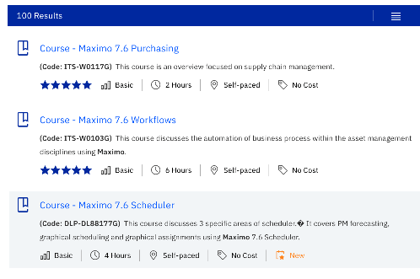

New Maximo IoT Skills Gateway
https://www.ibm.com/services/learning

Slide 9
Backup

Slide 10
Maximo Asset Management 7.6.x Feature Packs
7.6.0.1 – Inventory Reports / minimize downtime when you upgrade (updatedblitepreprocessor and updatedblite)
7.6.0.2 –reconcile purchase order and invoice costs, Federated MBO
7.6.0.3 – SAML Support, Asset Depreciation Schedules
7.6.0.4 – JSON Mapping , Remove Direct Printing Applet
7.6.0.5 –Work Center Introduction (Supervisor, Technician, Business Analyst), Object Structure Authorization
7.6.0.6 – SR Work Center, BA Data Set Designer, BIM Applications, License usage Monitor, Workflow Applet Removal
7.6.0.7 – reset passwords without restarting the server.
7.6.0.8 –Time Zone app, Budget Monitoring app, WC Authorization, WC Landing Page, Inspections
7.6.0.9 – Work Center Enhancement
7.6.1 – Inspection Form WC, Cognos 11, New Skin, WAS Liberty Support, Token Licensing
7.6.1.1 – API Keys, Sync Message Tracking, WC Configuration (queries), Dynamic JP, Inventory / Admin WC
IBM Watson IoT / © 2020 IBM Corporation
10

Slide 11
Maximo EAM with OpenShift
Documentation
How to deploy and run IBM®Maximo®Asset Management on Red Hat®OpenShift®.
  https://www.ibm.com/support/pages/node/1102509
OpenShift is the RedHat enterprise product for Kubernetes container platform.
The minimum version of Maximo required to using OpenShift containers is Maximo 7.6.1.1 with the current Interim Fix pack.
Only runs on RedHat Linux, but the administrative workstation to create the docker images can be Microsoft Windows server.
IBM Watson IoT / © 2020 IBM Corporation
11

Slide 12
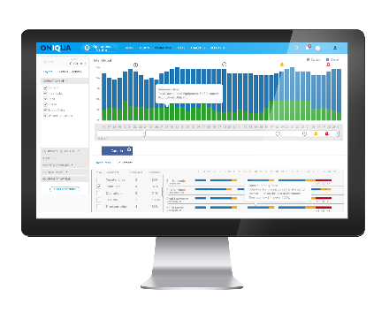
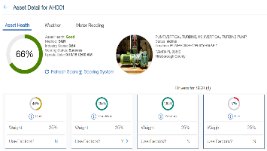
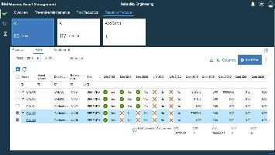
Maximo Health
Asset Health Visibility and Analysis
  Solution
  Consolidated global view of assets
  Health Visibility and Analysis
  Condition based actions
  Replacement Planning
  Capabilities
  Dashboard with cards, map view, spreadsheet view
  Fleet-wide view and health drilldown
  Health based notifications and actions
  Flexible health scoring by asset type or groups
  Sensor data integration
  Job plan efficacy analysis
  Refurbish / replace prioritization
  Benefits
  Reduce operational risk by focusing on the right assets
  Increase asset availability
  Reduce unnecessary preventive maintenance
  Reduce time to make capital replacement planning decisions
12
Notes:
Health is the first module in the IBM Maximo APM portfolio.
objective health scores
leverages EAM data, condition data from IoT platform
enabling customers to monitor across the fleet
equipment’s health and performance in near real-time,
Single source of truth
automate actions based on health

Slide 13
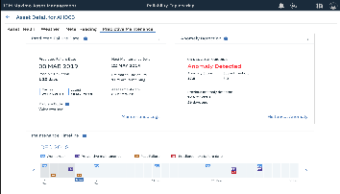
Maximo Predict
Predict Failures in Advance
  Solution
  Build asset failure models
  Predict failures
  Determine factors that contribute to failure
  Score models with current sensor data
  Capabilities
  Templates provided to build 5 common predictive models
  Score predictive models using Watson ML
  View pre-built visualizations for the 5 common models
  Use model scores to assess asset health with Maximo Health
  Benefits
  Reduced failures
  Reduced maintenance costs
  Improved asset utilization
  Extended life of asset
  Increased production output
13

Slide 14
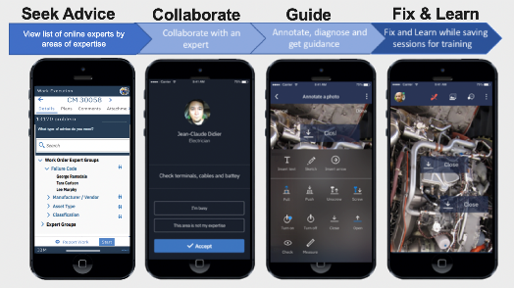
Maximo Assist: Peer Guidance
  Solution
  Connect with remote peer or expert
  Virtual collaboration via mobile phone
  AR-enabled intelligent visual assistance
  Capabilities
  Seek Advice: Connect with remote expert organized by area of expertise
  Collaborate: Expert and technician can interact via voice, chat and video
  Guide: AR tools for pointed guidance on how to perform actions
  Fix: Expert and technician can confirm issue is resolved
  Learn: Capture interaction for future reference and training
  Benefits
  Boost technician productivity
  Improve first time fix rate
  Reduce mean time to repair
  Capture tribal knowledge and reduce knowledge gap
  Reduce technician training costs
  Reduce maintenance and operating costs
14
Notes:
Health is the first module in the IBM Maximo APM portfolio.
objective health scores
leverages EAM data, condition data from IoT platform
enabling customers to monitor across the fleet
equipment’s health and performance in near real-time,
Single source of truth
automate actions based on health

Slide 15
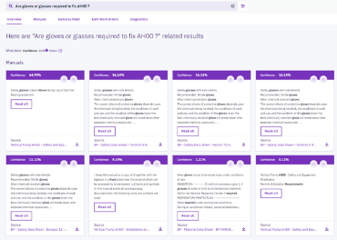
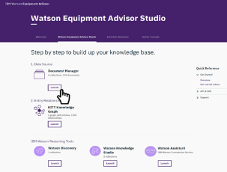
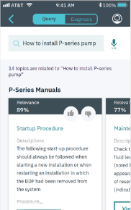
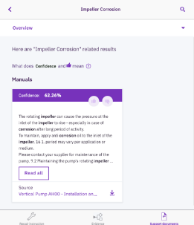
Maximo Assist: AI Guidance
  Solution
  AI Assistance for field technicians
  Search through historical remote assistance interactions
  Unlock insights from documents and data in your EAM system
  Create knowledge base by importing from major CMS systems
  Continuous response improvement based on technician feedback
IBM Assist Studio
  Capabilities
  EMA Studio Dashboard
  Insights engine for document understanding
  Diagnosis Models for troubleshooting problems
  Knowledge graph for capturing asset hierarchies
  Query analytics for tracking performance
  Plug and Play integration with Maximo Work Execution WC
  Intuitive technician UI with smart device compatibility
  Benefits
  Improve first time fix rate by up to 25%
  Reduce Mean Time to Repair by 10-15%
  Improve diagnosis accuracy and cut diagnosis time by 15%
  Improve technician productivity by up to 20%
  Standardize your maintenance and repair processes
15
Notes:
Health is the first module in the IBM Maximo APM portfolio.
objective health scores
leverages EAM data, condition data from IoT platform
enabling customers to monitor across the fleet
equipment’s health and performance in near real-time,
Single source of truth
automate actions based on health

Slide 16
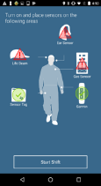
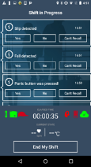
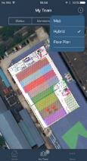
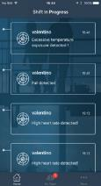
Maximo Safety
- with integration to
Maximo Oil & Gas/HSE
Visibility during hazardous conditions
Traceability and notification
Combining IoT data from wearables, environmental sensors and other data.
Real-time insights, putting time and place into context, along with trending and forecasting analyses, and worker information.
See Hazards and Notifications and trigger Incident processes in Maximo HSE.
Putting compliance at the center of safety, helps to identify and eliminate hazards in the workplace.
IBM Watson IoT / © 2019 IBM Corporation
16
IBM Watson IoT / © 2018 IBM Corporation
Notes:
Industry Challenges and Pain points in Life Sciences companies
Trends are:
* Continued emphasis on cost containment
Information-based medicine is becoming more and more a reality and requires specialized computing and data-intensive applications.
Emerging Markets (India & China) / Globalization
Customer pain points are really in line with the industry trends... But also:
Pipeline output is declining and paradoxically there is increased spending but decreased productivity.. Clinical Trial management is a core topic in drug manaufacturing balancing the business goals in making profit and on the other hand produce good quality drugs.. This process is time-consuming and very costly.
Increased regulatory compliance pressures from FDA can delay development and production of new drugs as well as increased focus on Post Market Surveillance (i.e. Phase 4 trials)
Increased focus on streamlining the supply chain within the total enterprise

Slide 17
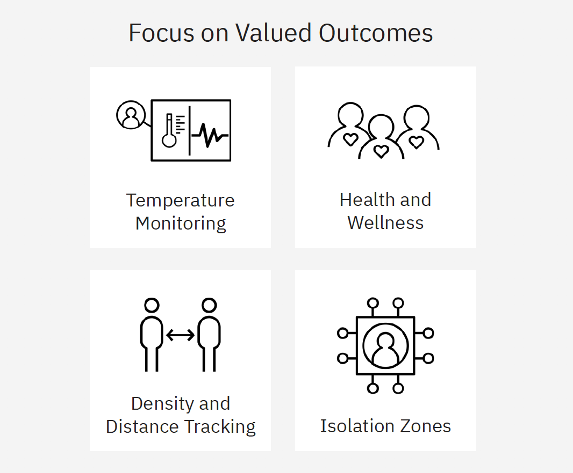









Maximo Worker Insights combines latest sensor technologies with analytics to provide insights and monitor potential risks
Social distancing scoring | Health monitoring | Occupancy monitoring | No-go zone monitoring & alerting | Crowd density management | Elevated body temperature monitoring | Face mask detection
+
X
Occupancy limits
Crowd Avoidance
Face Mask
Maximo Worker Insights utilizes inputs from optical and thermal imaging cameras, Bluetooth beacons and mobile phones to provide analytical insights to workers and supervisors for a wide range of critical use cases
Solution based on :
Bluetooth Beacons and Smart Phones
Wearables
Cameras

Slide 18







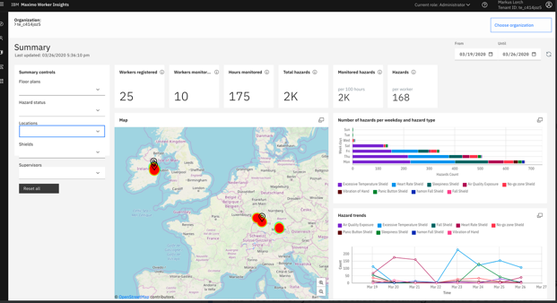


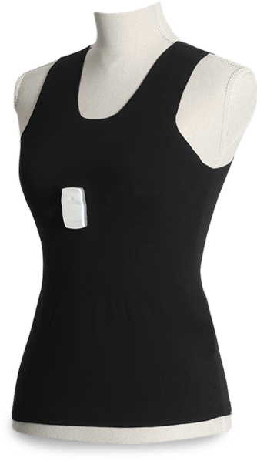

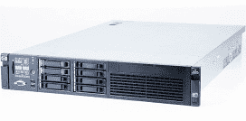



Maximo Worker Insights
Prescriptive and just in time analytics to assist employers in improving workplace safety
Gateway
IBM provided device integrations
Wearables Sensors
Supervisor / Employee Notifications
Worker
Mobile App
Edge
Maximo
Worker Insights
Real-time and historical dashboard
(Senior Management / Executive View)
Partner provide device integrations
Partner Gateways
Dashboard / KPI’s / Monitoring
Near real time data from leveraging IoT technology from workers and assets
Maximo HSE / Oil and Gas
Incident Management Process
System processes automatically triggers the Incident Management process
Data automatically fed to HSE incident management system
System processes rules to determine if event was actual incident
IBM AI Analytics / © 2020 IBM Corporation
18
Time

Slide 19

Upgrade
Anywhere 7.6.2, 7.6.2.1, 7.6.3, 7.6.3.1
your applications will migrate seamlessly if....
Utilized the delivered Anywhere applications as is
Configured the Anywhere applications following standard, best practices
Customized the Anywhere applications following standard, best practices
Cloned an existing Anywhere application to create new application
Created a new Anywhere application

Slide 20

Upgrade
Anywhere 7.6.2, 7.6.2.1, 7.6.3, 7.6.3.1
your applications will not migrate seamlessly if....
Implemented specific Mobile First features to Anywhere application (ex. Integration Adapters)
Created a native code within Mobile First and applied to Anywhere application

Slide 21

Upgrade
Minimum Maximo Version
Minimum Maximo Version is 7.6.0.8
If you are using push notifications, best practice is to be on Maximo 7.6.0.10
Additionally, for push notifications, a separate iFix install to enable the Push notification application is required until Maximo 7.6.1.2

Slide 22
Maximo Anywhere 7.6.4 details
Architecture
Administration and Configuration
User Experience

Slide 23

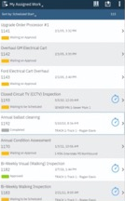
Architecture...simplified
Prior Anywhere releases
Anywhere 7.6.4
Maximo
MBOs
REST APIs
Maximo
Maximo database
Anywhere
MBOs
REST APIs
Middleware
Maximo database
Device database
Device database
Middleware database

Slide 24
Install: Product...simplified
Prior Anywhere releases
Anywhere 7.6.4
1. Maximo Server
2. Middleware
3. Anywhere Build Server
Maximo Server
Anywhere Build Server
Web sphere Liberty
Anywhere Project
Anywhere Admin app updates ex. Deployment
Anywhere Server updates
Anywhere
Server updates
Anywhere Project
Middleware Console, App Center
Build Environment
Anywhere
Database updates
Anywhere
Database updates
Anywhere app definitions
Build Environment
Middleware DB2 Database
Middleware Plug-In
Anywhere install demo: 20 minutes | https://ibm.co/2UM5FMK

Slide 25
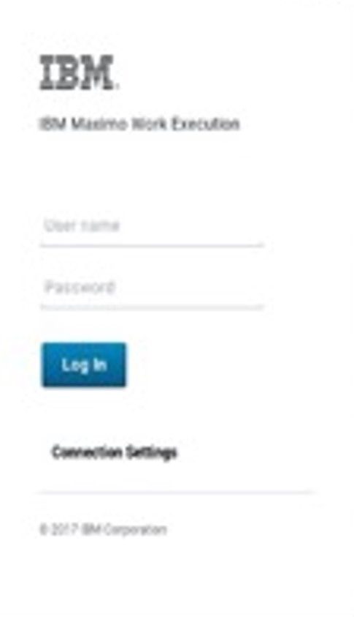
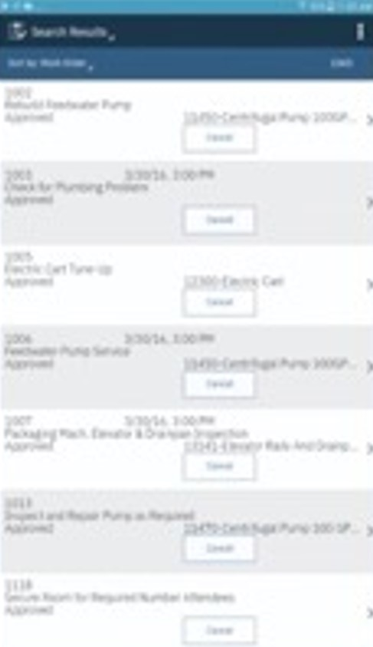
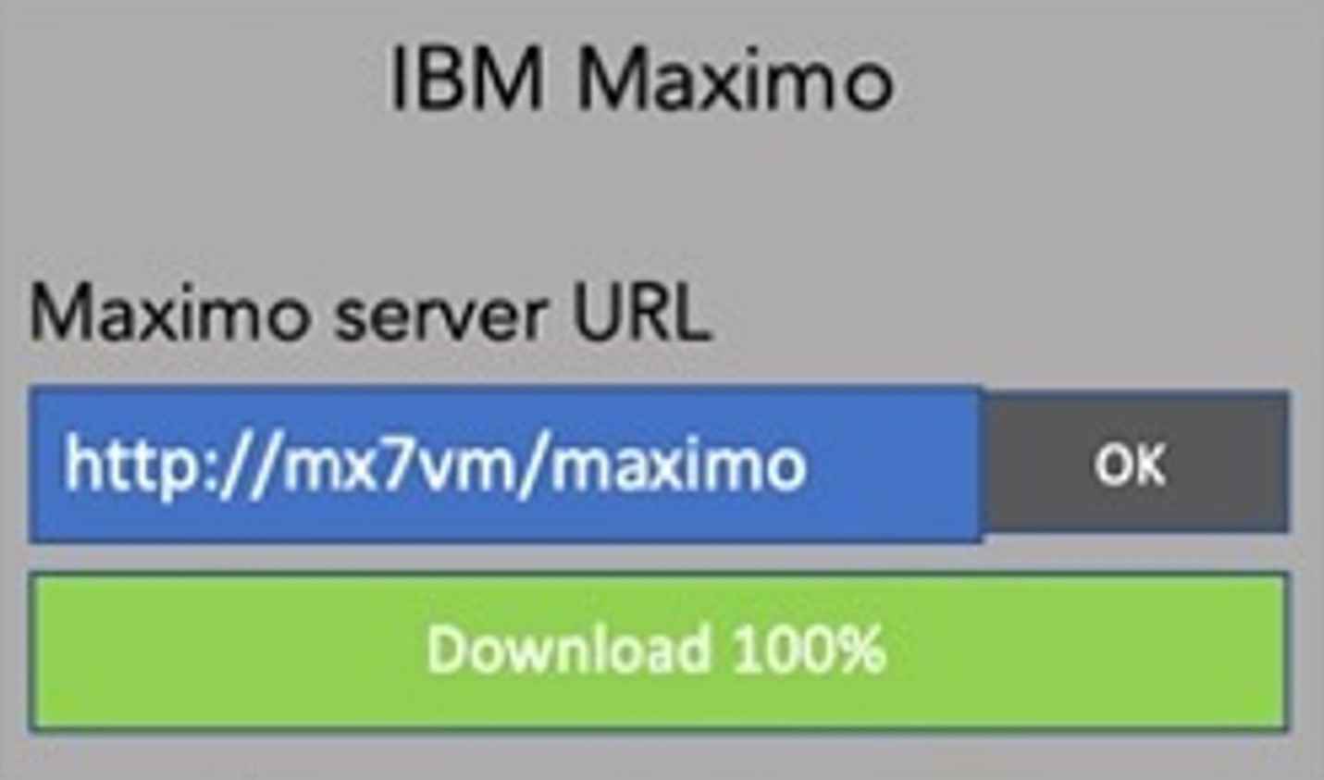
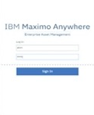

Install: App...streamlined
Prior Anywhere releases
Anywhere 7.6.4
1. Download app to device
2. Enter Middleware url
3. App updates and data installed on device
3. Middleware communicates with Maximo
1. Download
Anywhere to device
2. Enter
Maximo url
3. App updates and data installed on device
Maximo
Middleware
server
Maximo

Slide 26

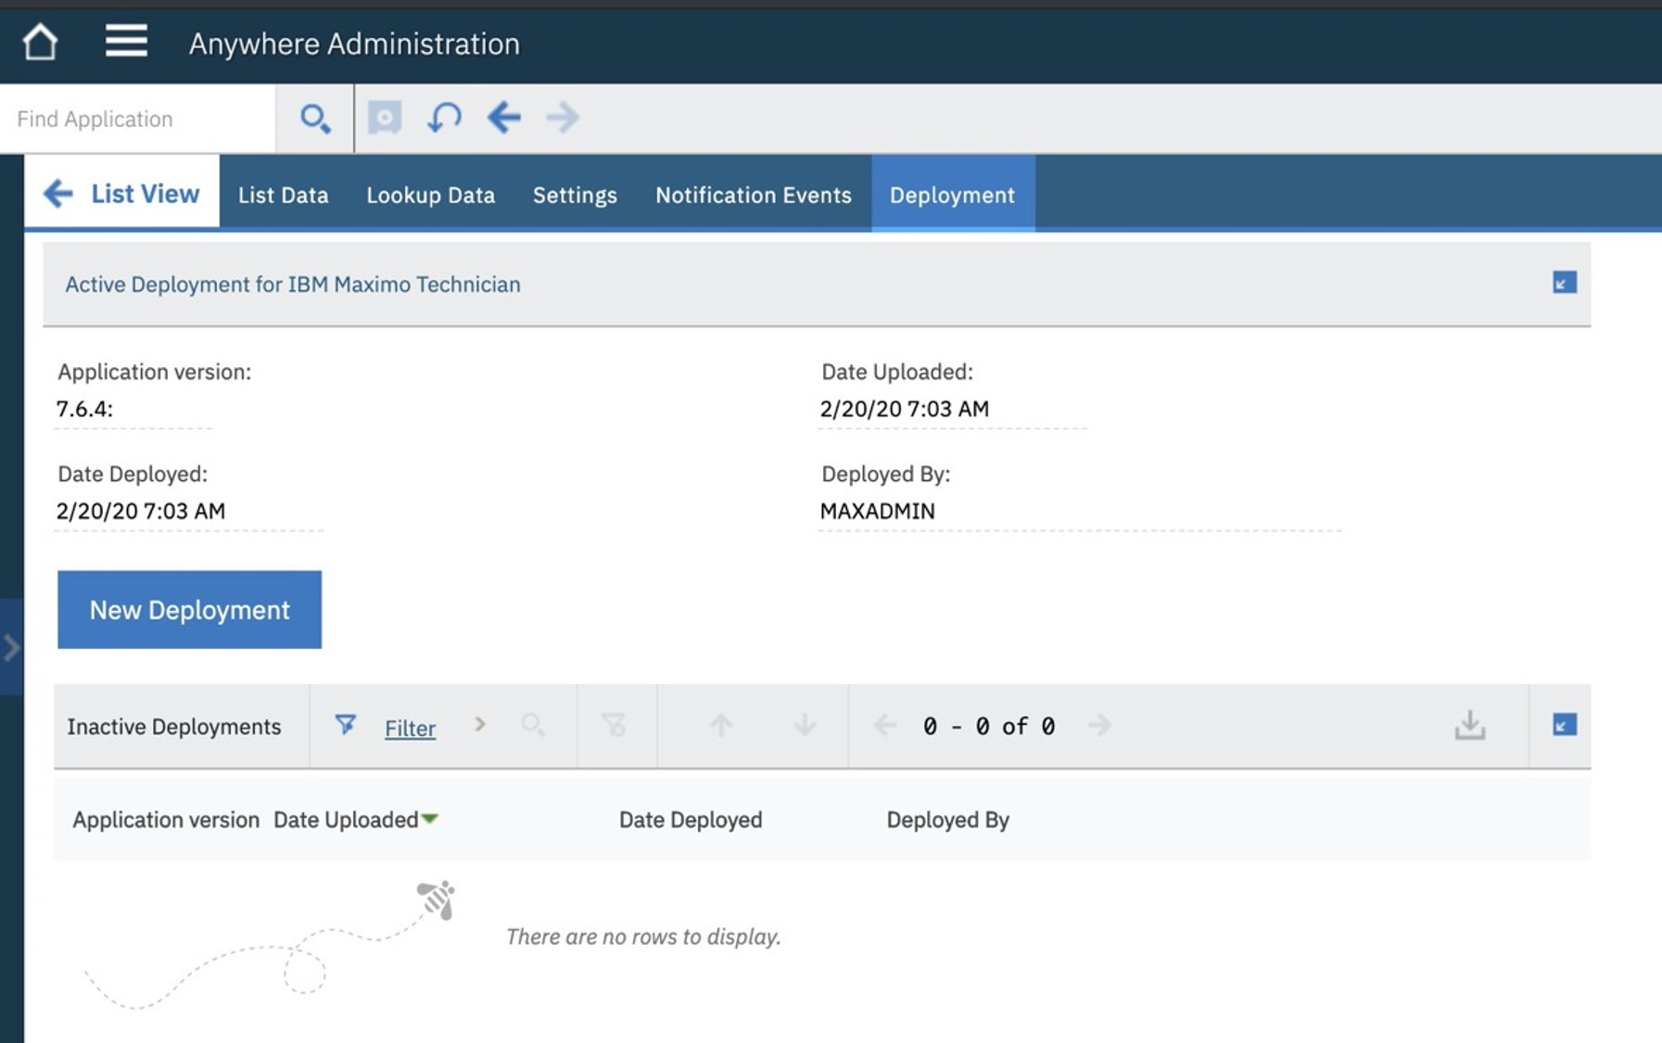
Administration...enhanced
define queries
lookup data
push notifications
deploy applications

Slide 27
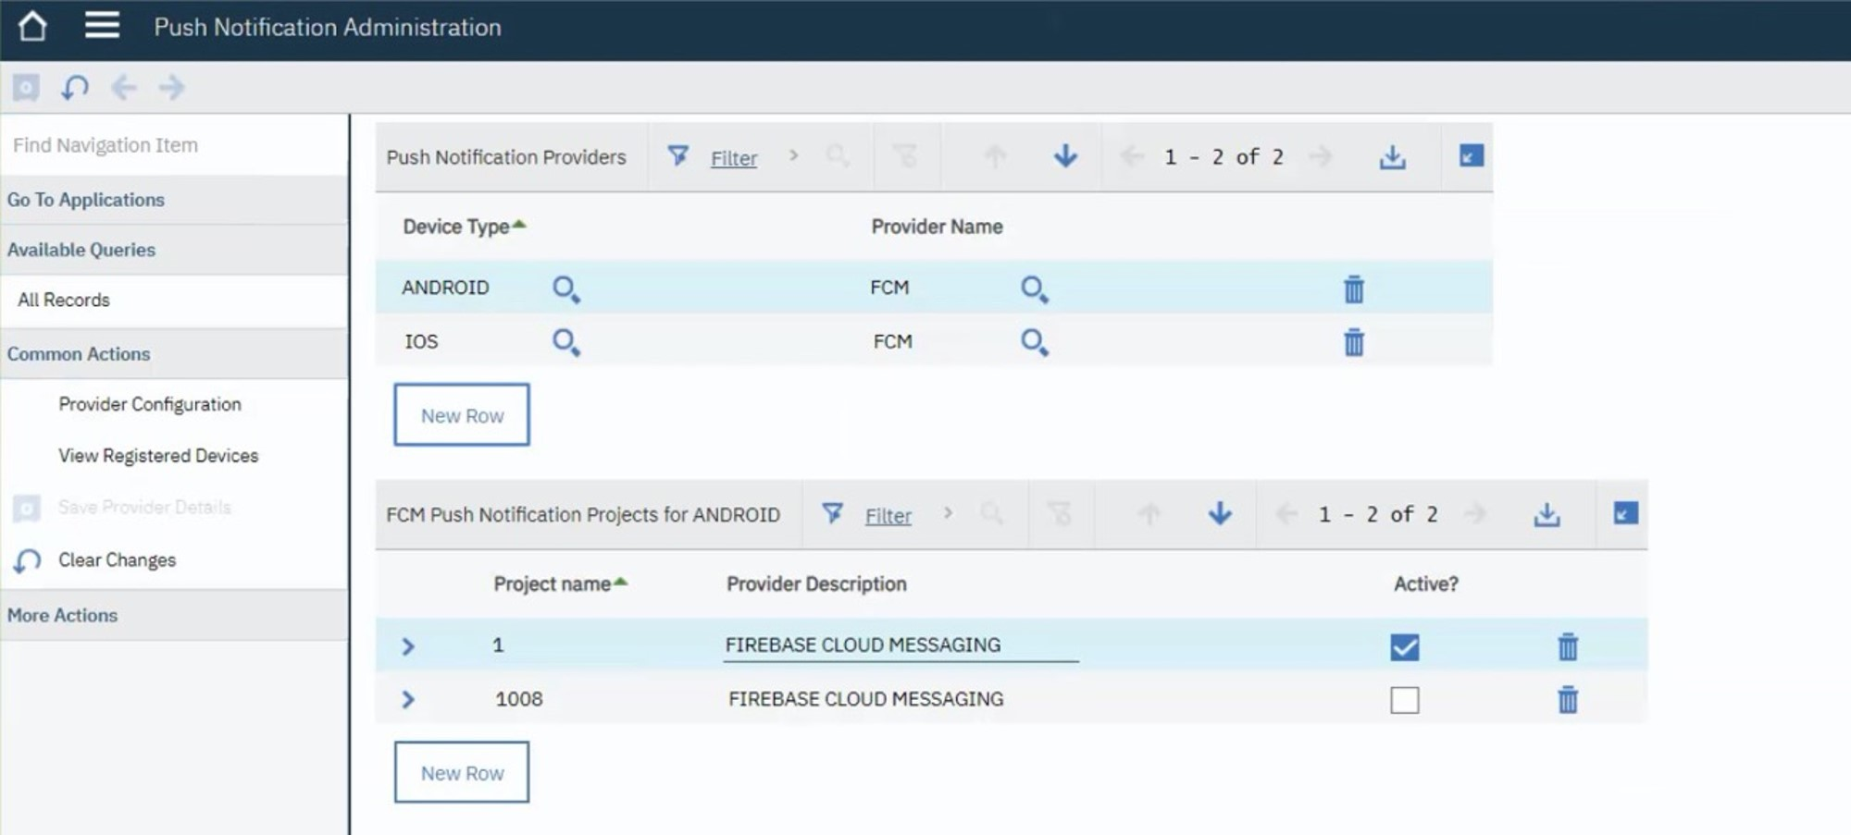
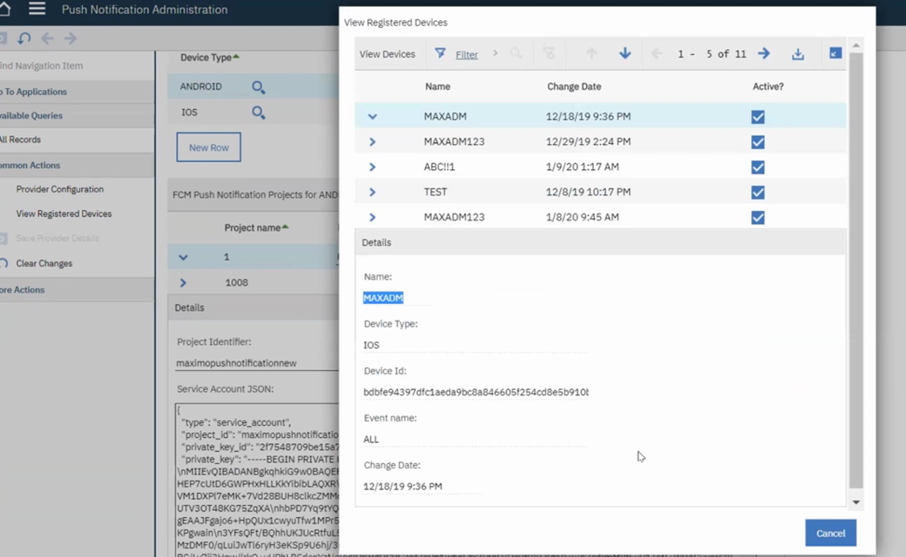
Administration: Push notification application...new
*Push Notifications separate iFix install until Maximo 7.6.1.2

Slide 28
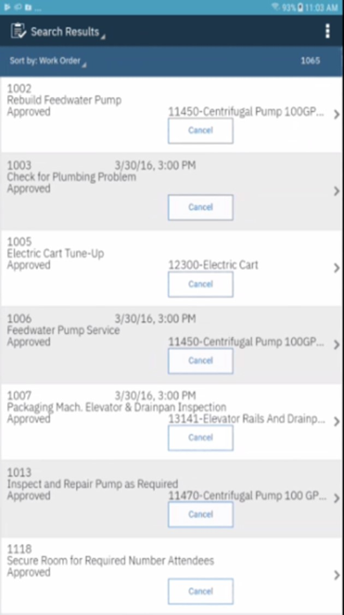
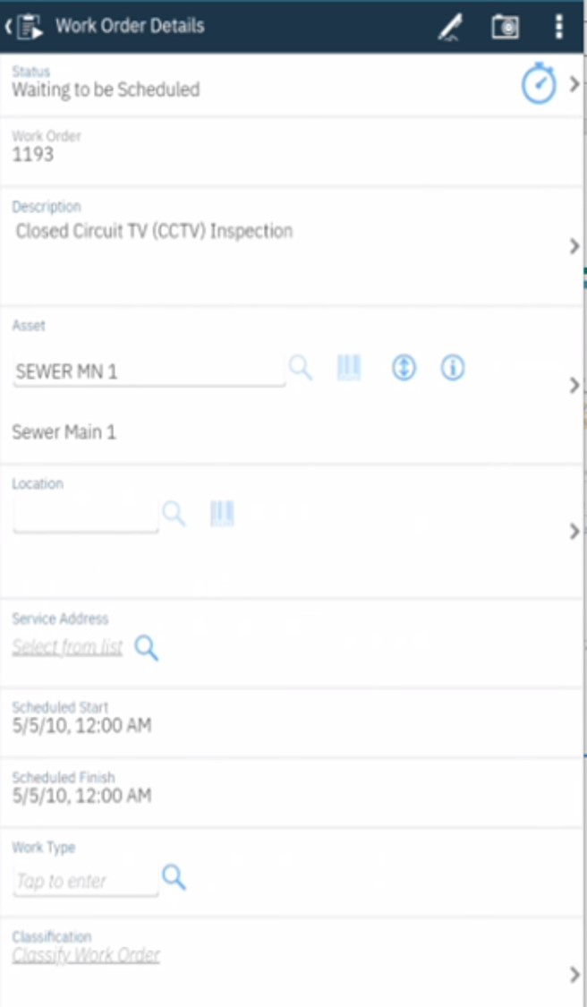
User Experience: Same for ease of upgrade
Anywhere 7.6.3.1
Anywhere 7.6.4

Slide 29
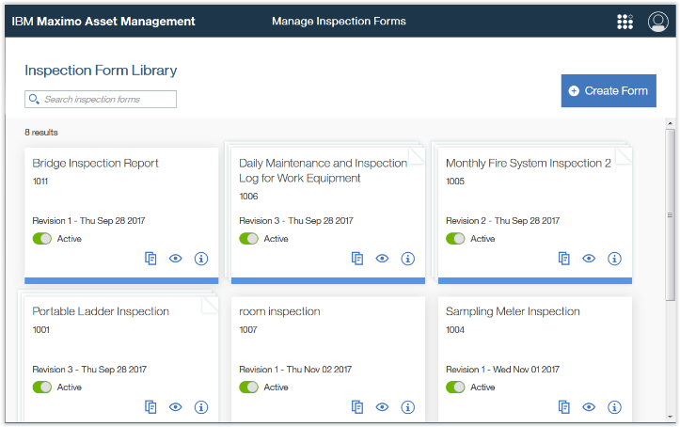
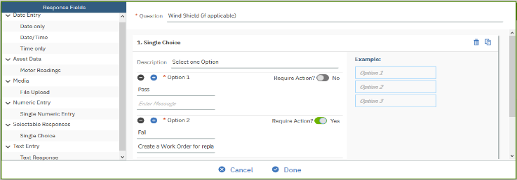
Inspections – Manage Forms
Provides capabilities to define an electronic inspection form:
Accommodate requirements of traditional paper based inspections
    Group questions, mark required.
    Attach documents, free form text, meter readings
    Conditional Questions
    Colors and Icons to indicate response
Revision control
Audio guided inspections and follow up actions
Used for Job Plans and Routes
PM can be set up for recurrent inspection on assets and locations
29
Notes:
Provide capabilities to define an electronic inspection form:
Ability to define Groups, questions and responses of several types, including meter readings, attachments, date, time, list of options as well as free text and numeric
Each form, group of questions or individual questions can contain Instructions to guide the inspector to report the results
All forms are revision controlled keeping track of its changes and results
Form settings available to enable audio guided inspections and follow up action

Slide 30
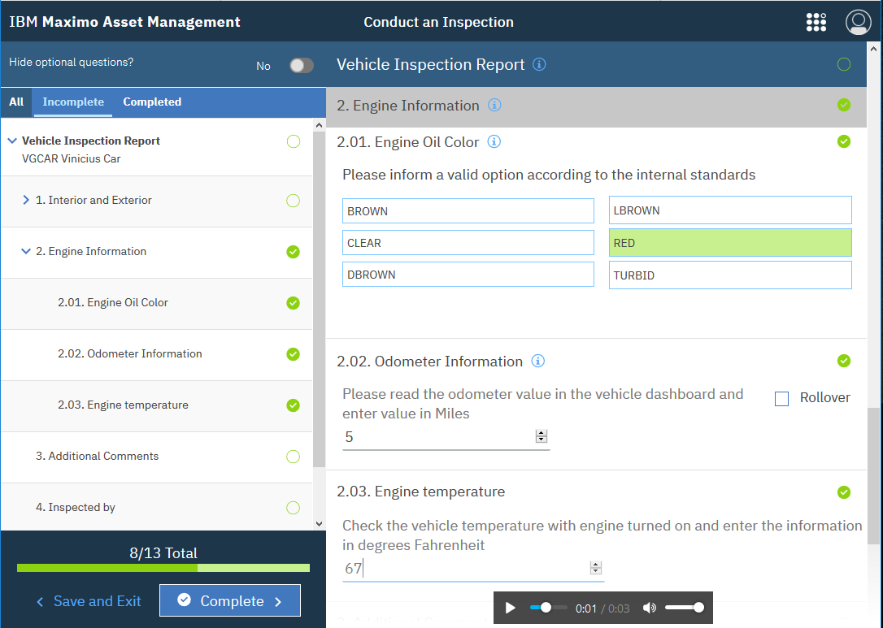

Inspections – Conduct an Inspection
Report results in a connected mobile device
Inspection statuses are managed automatically and differentiate pending, in progress and completed results
Easy and intuitive navigation to report and visualize single or multiple inspection results
Search and evaluate individual completed inspection results
Associate results to Assets and Locations, WOs and tasks
Historical Inspection results are presented in both Assets and Location applications
Leverages Watson services to conduct a hands free inspection by just using voice responses.
30

Slide 31
New in 7.6.1.1: Manage Inventory Work Center
1.
2.
Easier set-up
Faster transactions
Add storerooms
Set up item master
Define units of measure
Bins, lots, and rotating items
Create initial balances
Update balances
Issues and transfers
Fulfill reservations
Return issued items
Physical counts
31
Notes:
The main thing here is the ease of performing various tasks from one list, where in Classic the user needs to call different actions.
It would be good to mention that all actions are controlled by SigOptions we added. Stakeholders asked about it from the start.
If you are asked, the storeroom/item list is showing data from both the Inventory and Invbalance objects.

Slide 32
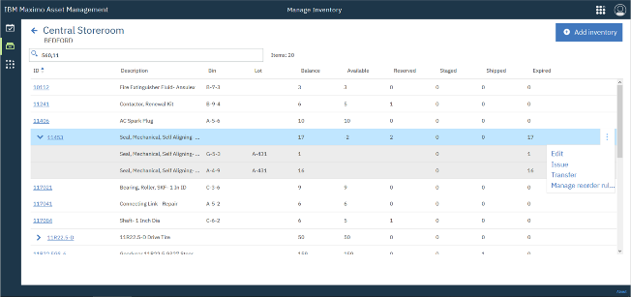
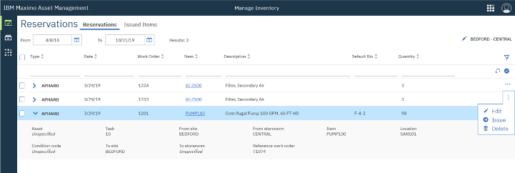
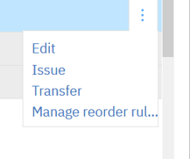
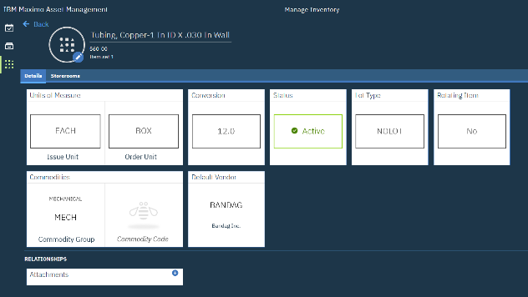
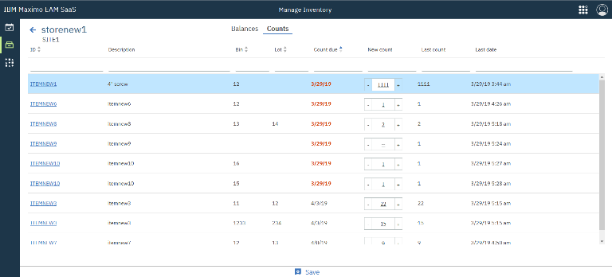
Manage Inventory – Perform actions in context
Create, View, Edit, Issue and Transfer directly from a row from Storeroom or Reservation
Add or edit units of measure in-context
Intuitive Physical Count with Multi-column sorting
Notes:
Manage Inventory
Easier set up and faster transactions
users with authorization can create new UoMs and Conversions from the Detailed page.

Slide 33
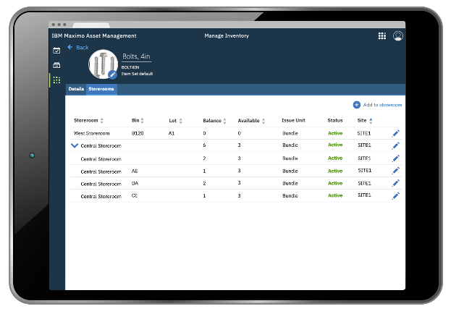
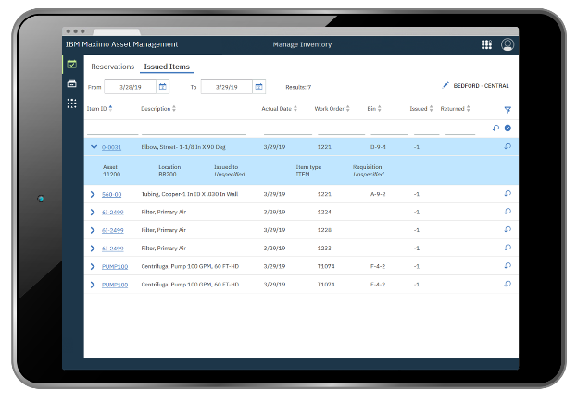
Manage Inventory: Improved summary information
Item storerooms
Balances for a single item across the org
Bins as child rows with balance roll-up
Issued items list
See what has been issued from your storeroom
Return items to the bin & lot they came from
33

Slide 34
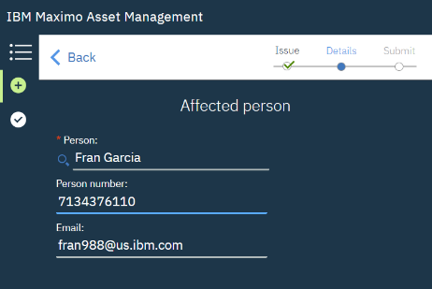
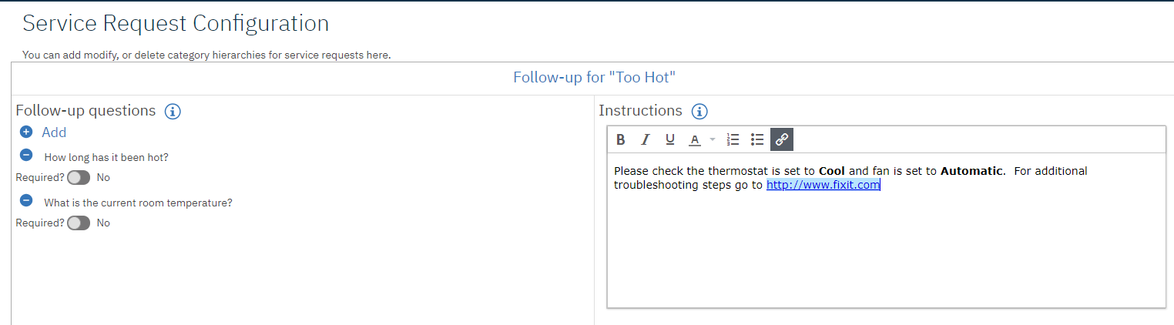
Service Requests in 7.6.1.1
Category search
Affected user
Enhanced code scanning
SR Configuration screen
SR triage view: Batch-actions
Performance improvements
34
34

Slide 35
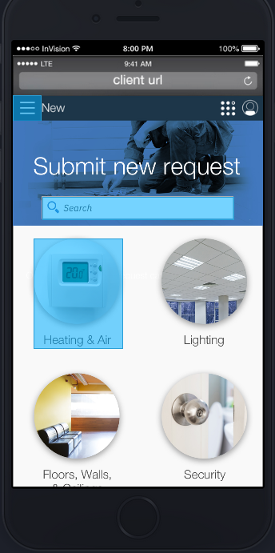
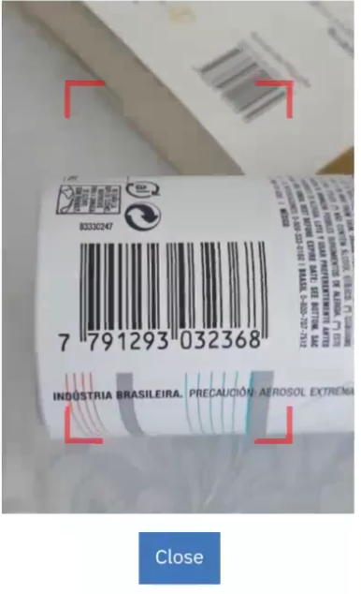
Service Requests in 7.6.1.1 - Improved code scanning
    Camera is now opened in video mode instead of photo
    Red view finder frame is overlaid to help the user focus
    When the code is in focus it snaps to the picture and renders the ID
    An audible beep will sound to indicate success
Supported codes:
Devices:
  • Codabar
  • Code-39
  • Code-93
  • Code-128
  • EAN
  • EAN-8
  • Interleaved 2 of 5
  • QR code
  • UPC
  • Android/Chrome
  • Apple/Safari
  • Windows/Edge
35

Slide 36
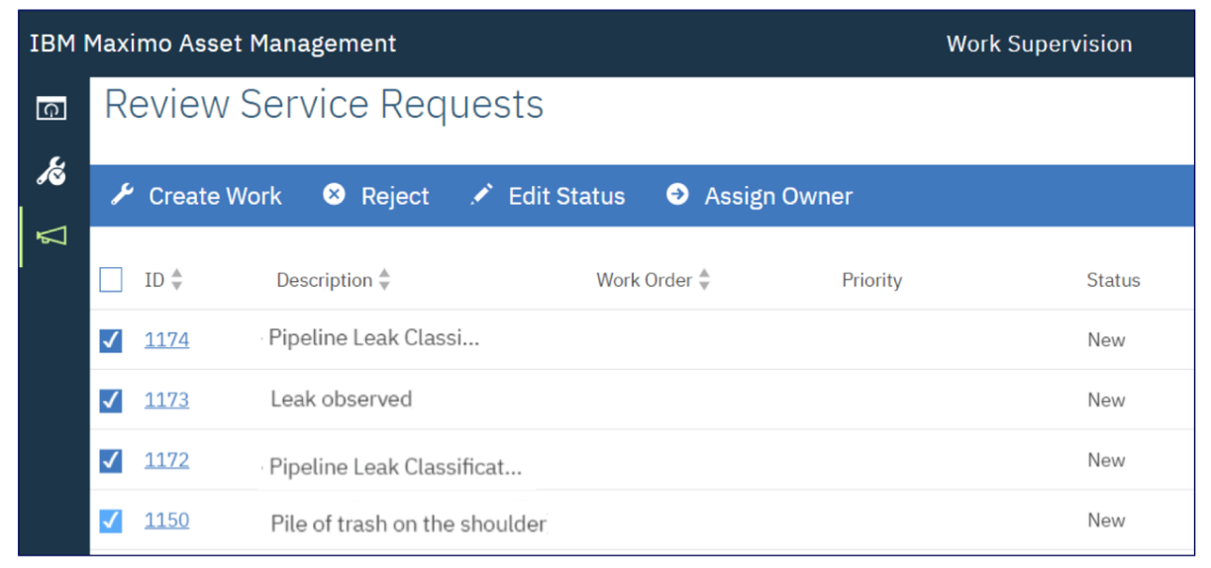
Service Request processing page Enhancements
Perform an action against multiple requests
36

Slide 37

Targeted Civil Infrastructure Capabilities
Cable Vibration
Weather History
Pillar Settling
Drain Cleaning Schedule
Closure Optimization
Steel Corrosion
Bearing Failure Prediction
Traffic and Weight Sensors
Concrete Cracks
Earthquakes
CI Tools
Closure Optimization
Next Best Action
Regulatory Advisor
Civil Infra Configuration
Cable, Hanger, Deck, Bearing…
Bearing PM, Drain PM…
Concrete Inspection, Cable Insp.
Vibration, Settling, Sway vs Wind
Bridge Health, Cable Health,…
Bearing Failure, Strand Failure…
Concrete Crack Model, Steel Corrosion…
Core Function
Asset Classification
Preventive Maintenance &Job Plans
Inspection Work Center, Defect Mgmt
Sensor Data Capture and Smoothing
Reliability Engineer WC
Predictive Algorithms
Visual Analytics, Drone flight mgmt
EAM
Monitor
PMI
PAIV/Drone Plat
IBM Watson IoT / © 2020 IBM Corporation
37
Notes:
Building on existing Watson IOT/Maximo foundation, add Civil Infrastructure Configuration and address key gaps in the core products, then add Civil infrastructure specific applications and expand the model library
Start with Asset Management – improve the way inspections and work orders are done on linear assets in a corridor, synthesize the spatial, linear and BIM views, reduce time to onboard with models in the digital twin exchange and improvements to loaders, add health models and integration to visual analytics, introduce the drone platform to reduce cost of repeat inspections.
Mention weather and sensor examples

Slide 38
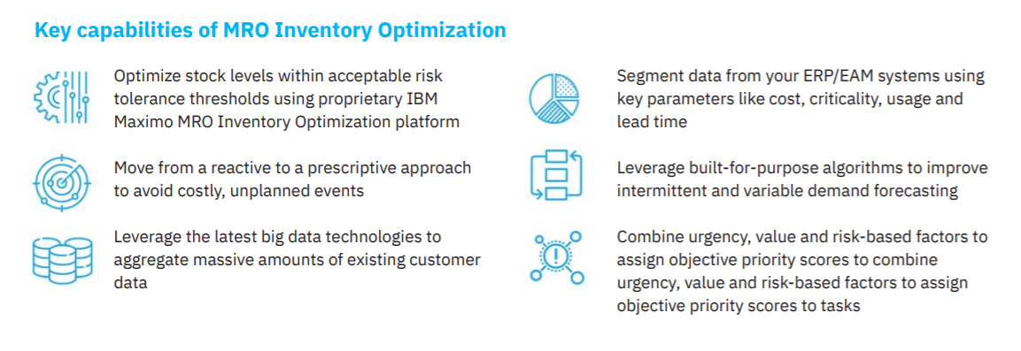
MRO Inventory Optimization
Provides users with an accurate, detailed picture of their MRO inventory performance and powerful capabilities to make informed decisions that balance cost and risk to optimize MRO inventories
Systematic decision support tool grounded in the industry-leading and proprietary algorithms
Easy to use user interface
SaaS Deployment
Standard connectors with SAP & Maximo
ISO 27k certified
5
https://www.ibm.com/services/process/mro-inventory
38

